Slide 1
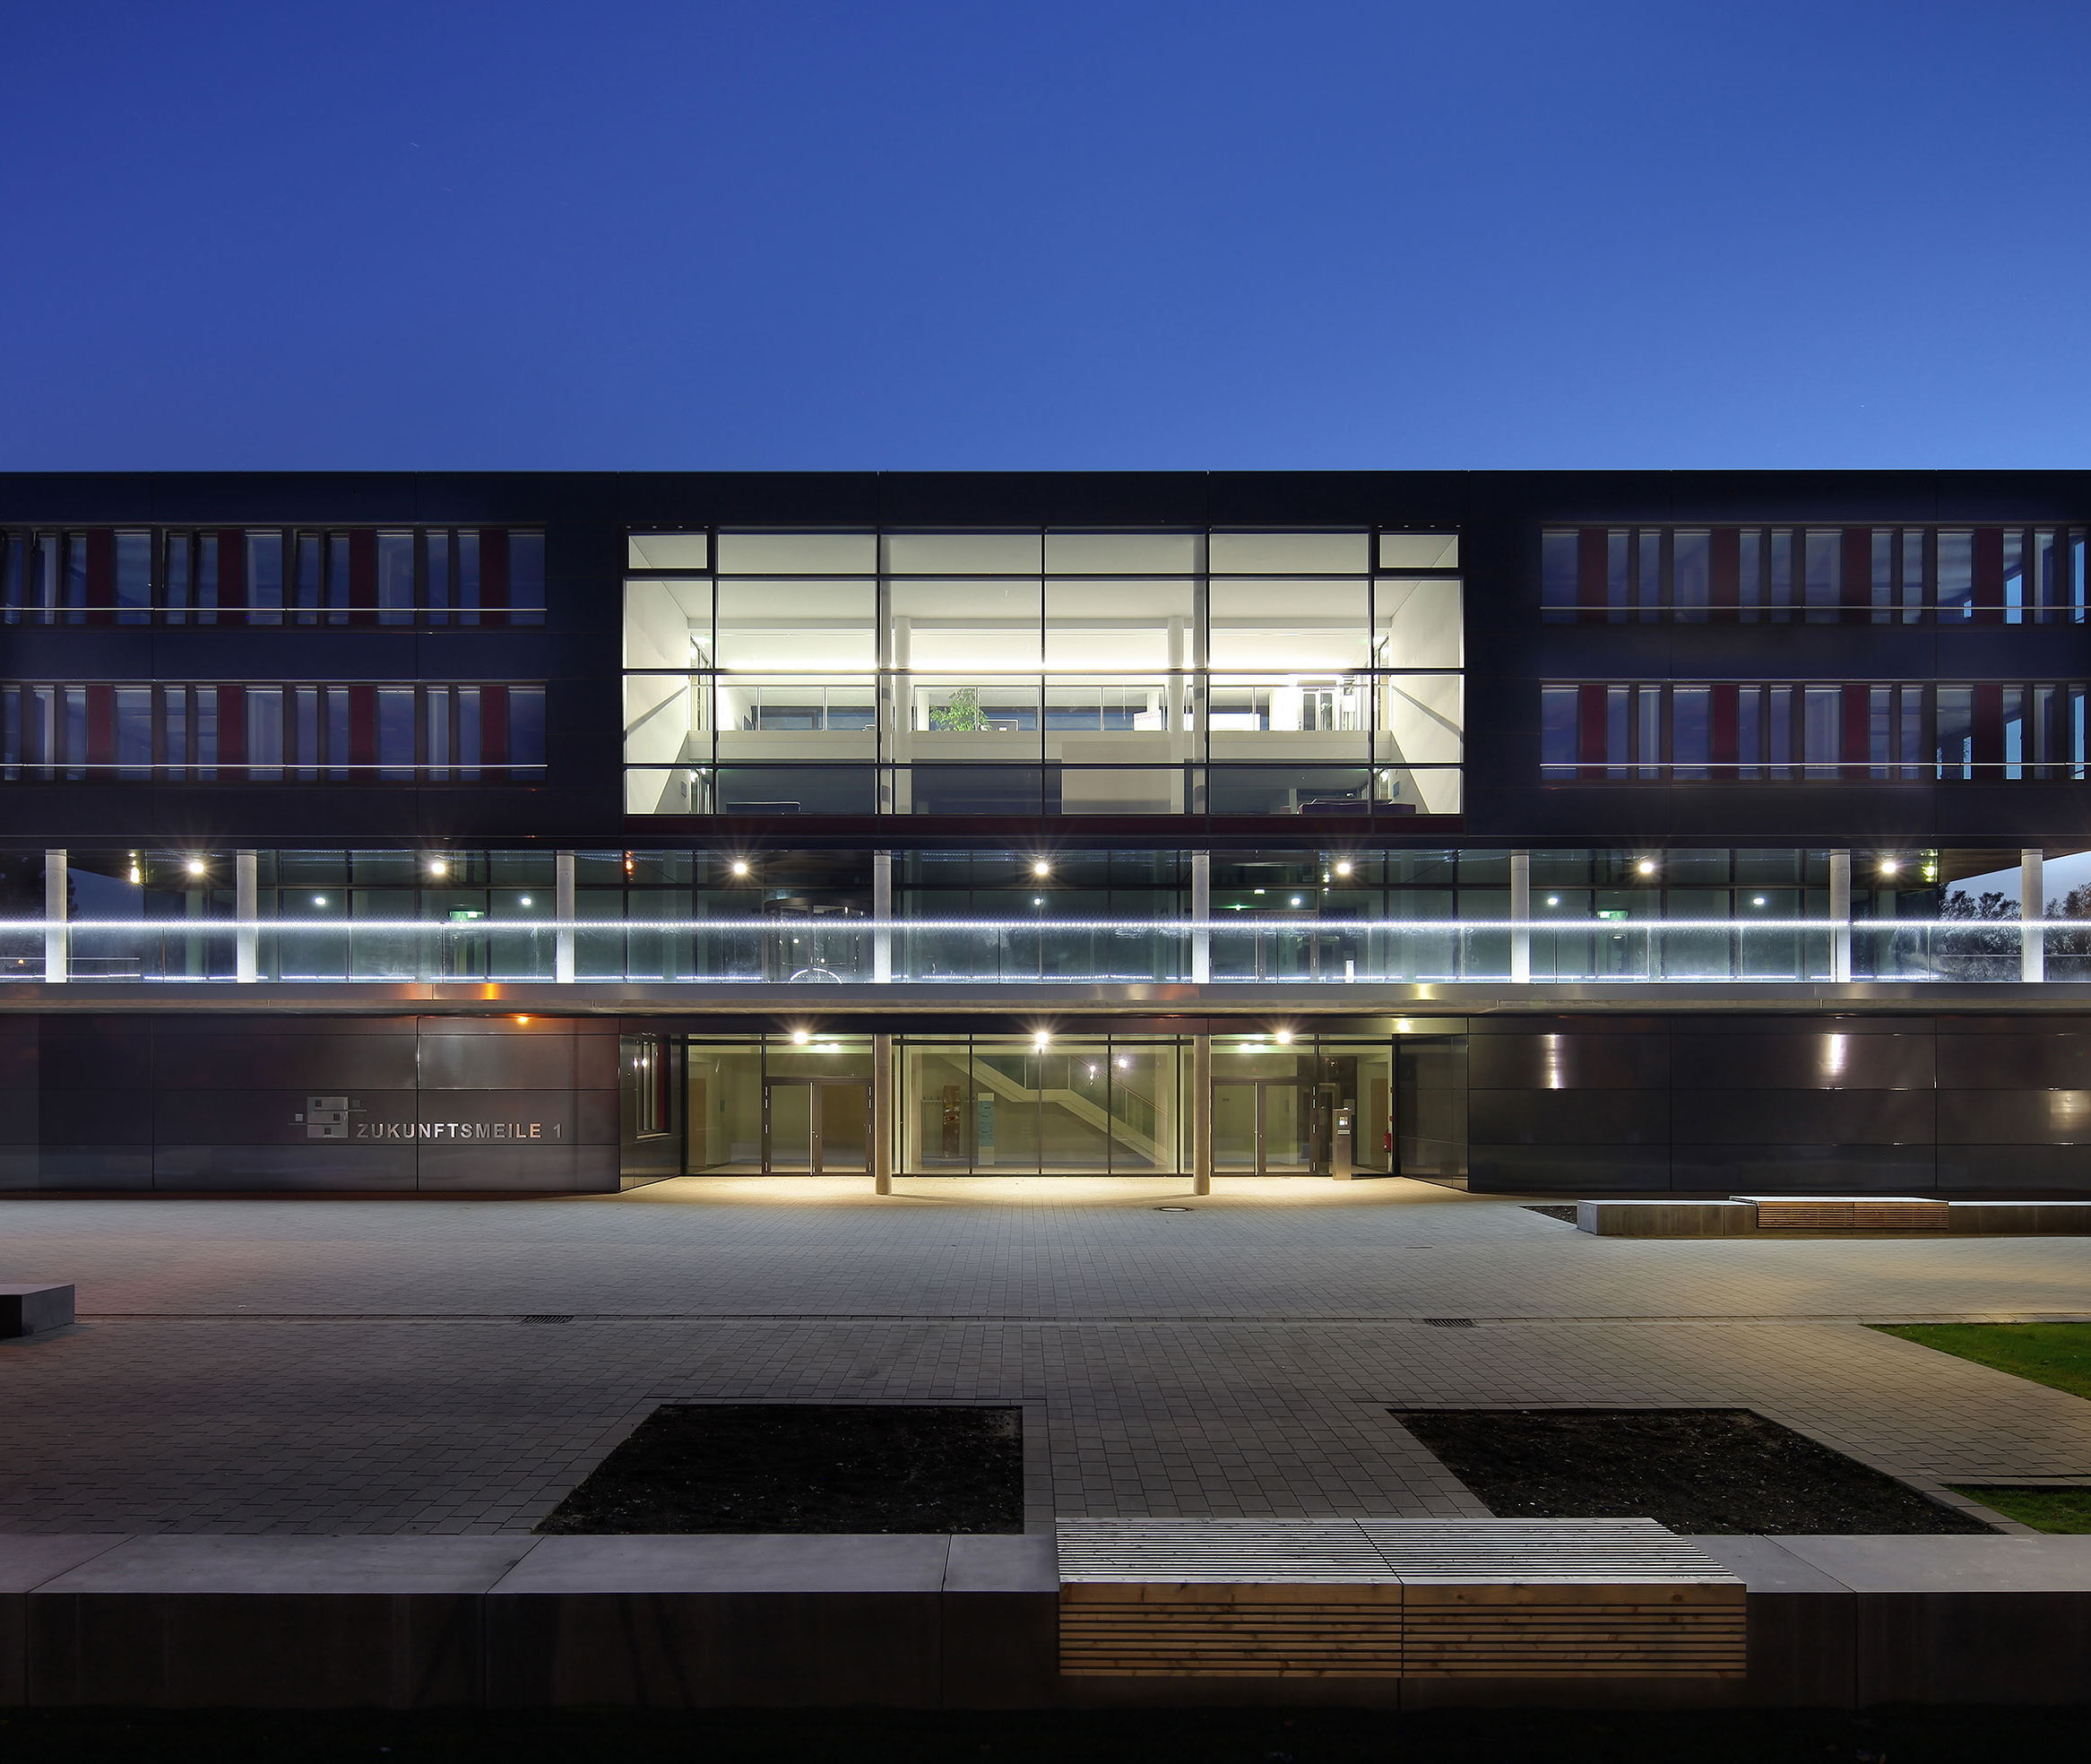
Foreign Object Detection System
6987112 Lal, Amal Nimmy
4011205 Deshwal, Aryman
6818900 Eranki, Varun Maitreya
4025318 Kothandaraman, Jagannath
6757069 Illapogu, Pranuthi

Slide 2
Titel
Subtitel
(Each) First name Surname
Intelligent Technical (Sub-)System

Slide 3


Agenda
Foreign Object Detection System(FODS) - Introduction
Architecture Diagram
Concens
SysML
Summary

Slide 4
FODS - INTRODUCTION
1

Slide 5
INTRODUCTION
FODS
Part of Intellegient Airpot System (IAS)
Uses AI to detect foreign objects.
Gets information from various other systems like GPS, weather forecast etc.
Prioritises different kinds of alerts and notifications.
Assists stakeholders – Air traffic control, ground crew, pilots etc.

Slide 6
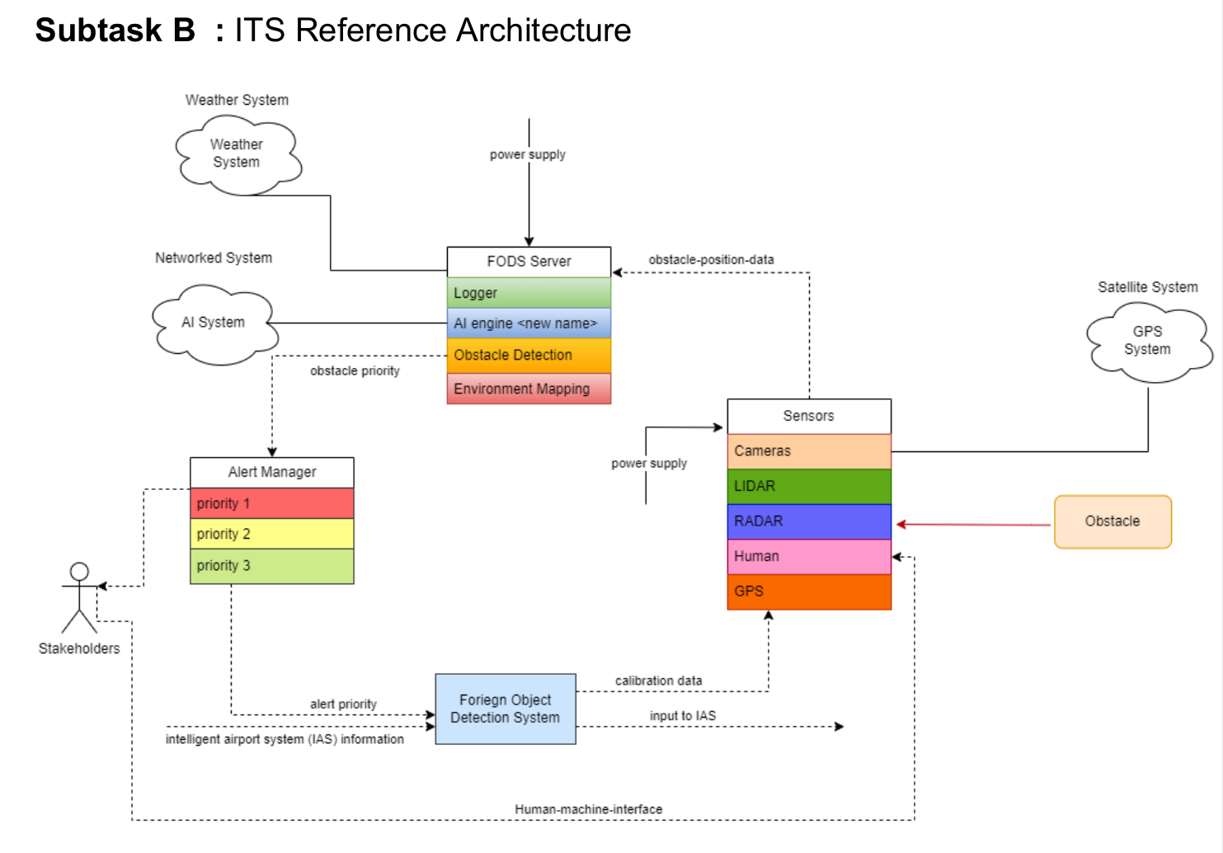
Architecture Diagram

Slide 7
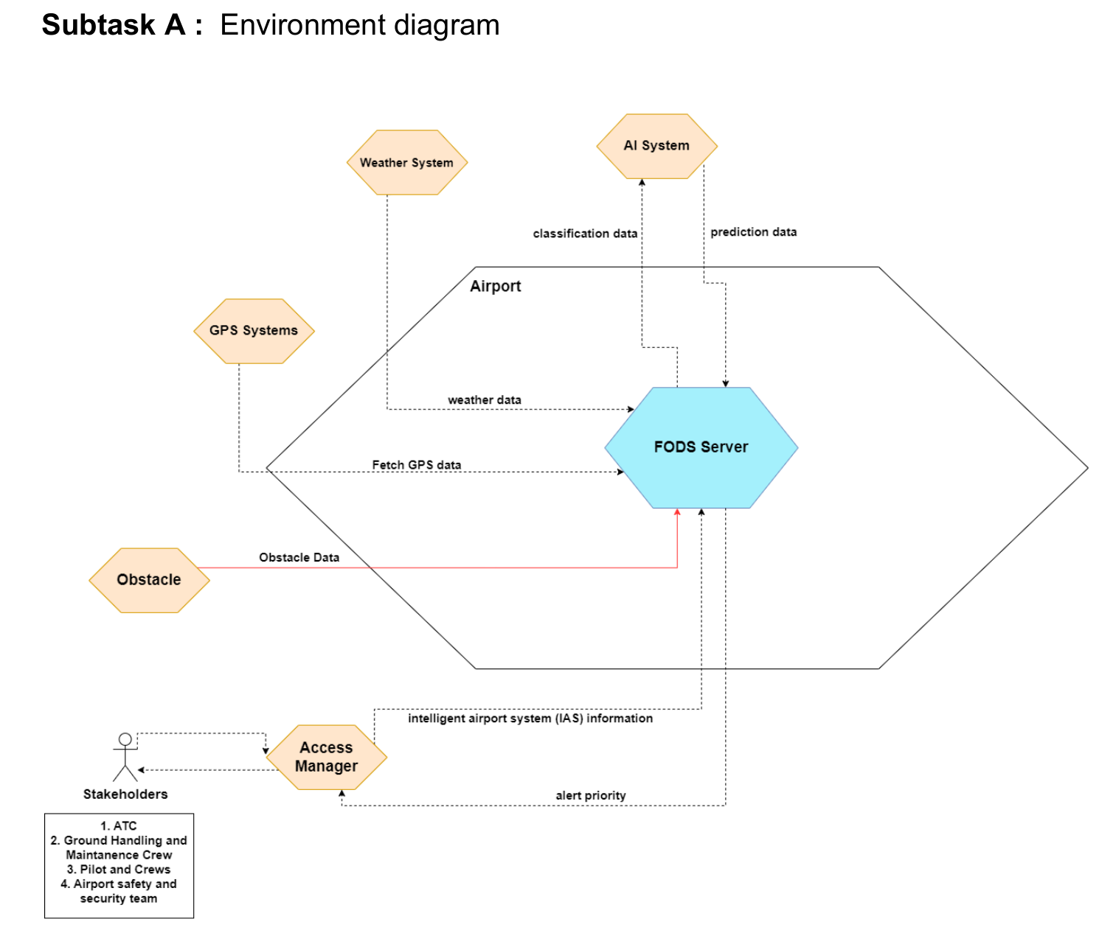
CONSENS
Environment Diagram

Slide 8
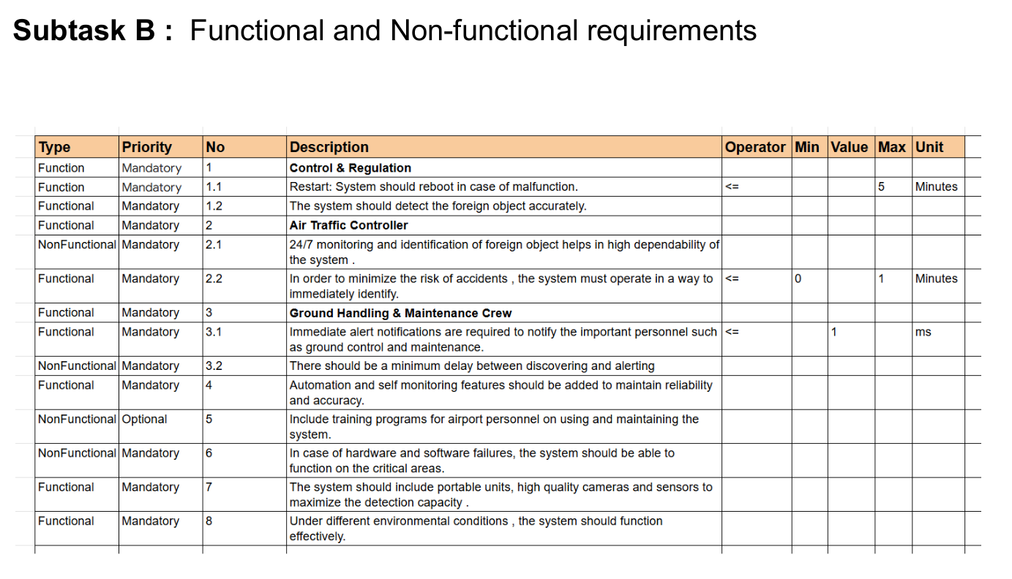
CONSENS
Functional and Non-Functional Requirements

Slide 9
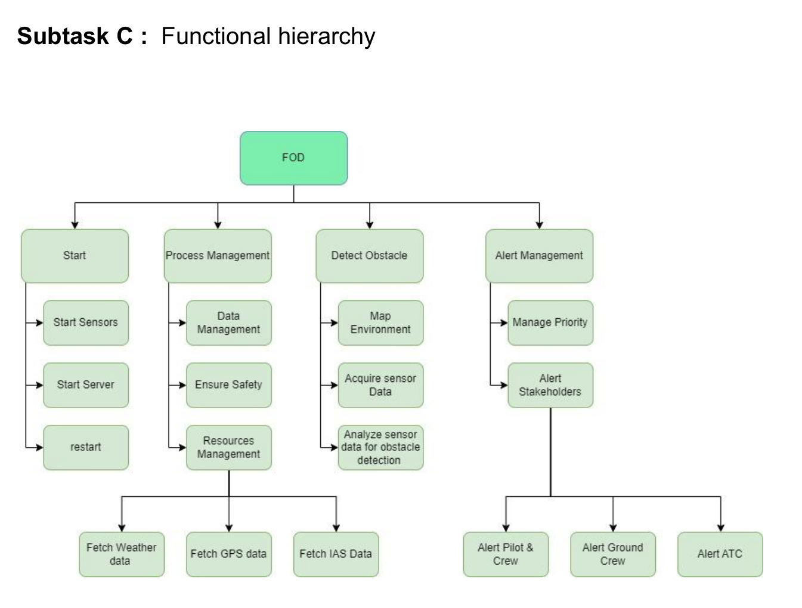
CONSENS
Functional Heirarchy

Slide 10
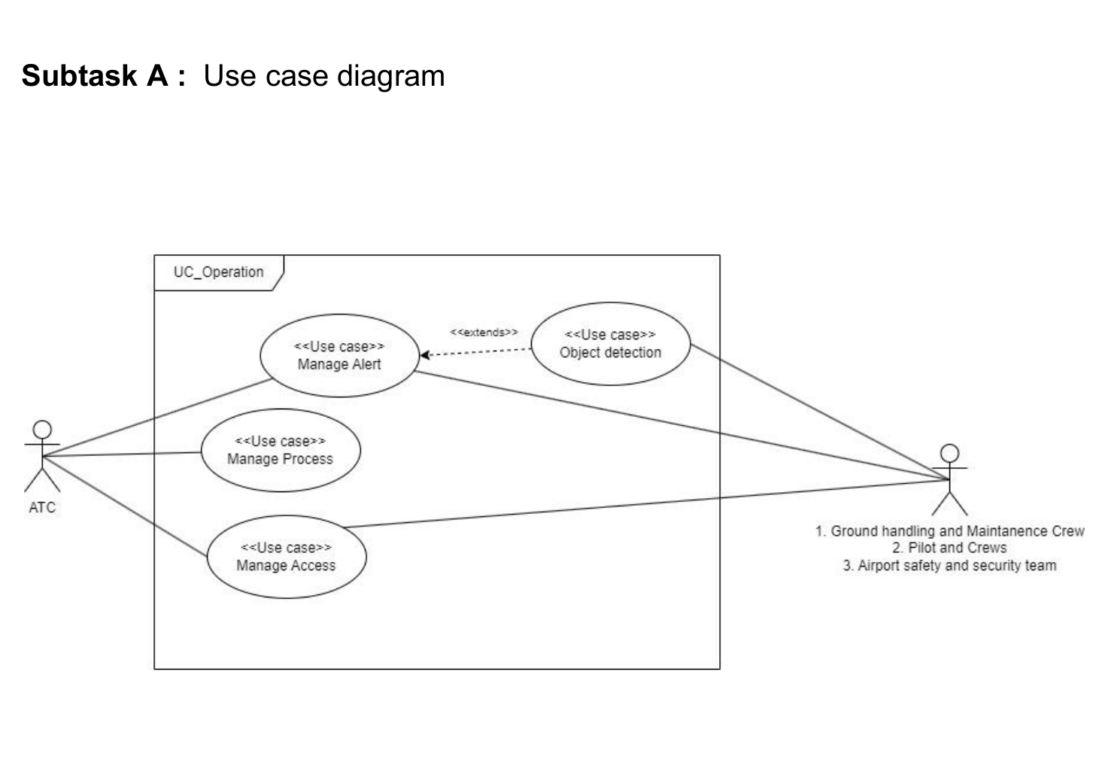
SysML
Usecase Diagram

Slide 11
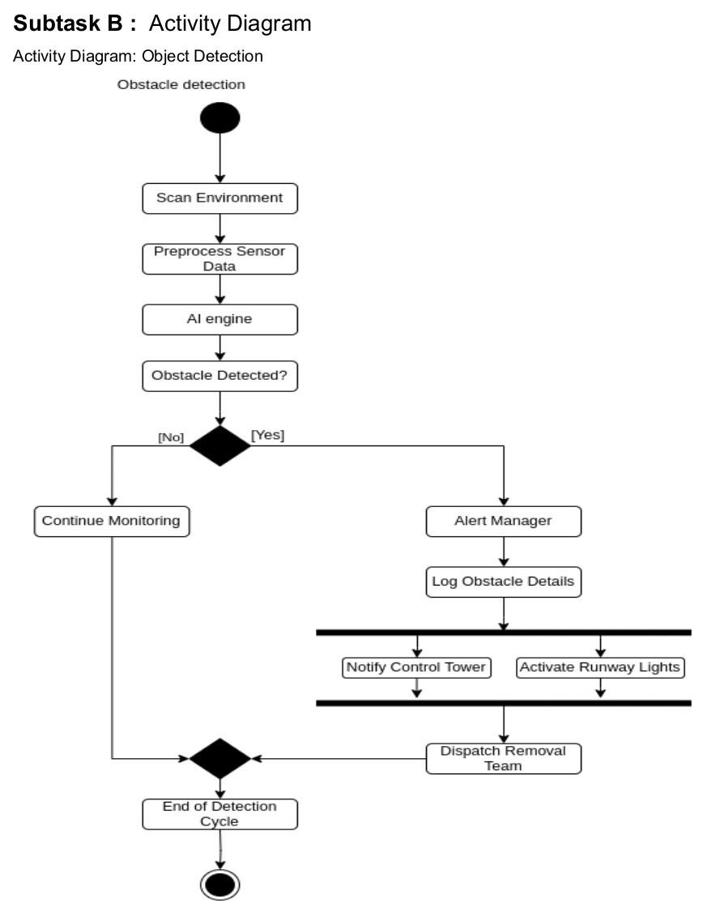
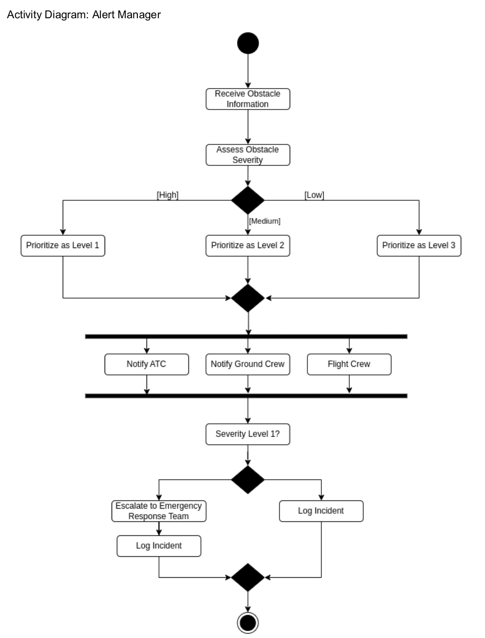
SysML
Usecase Diagram

Slide 12
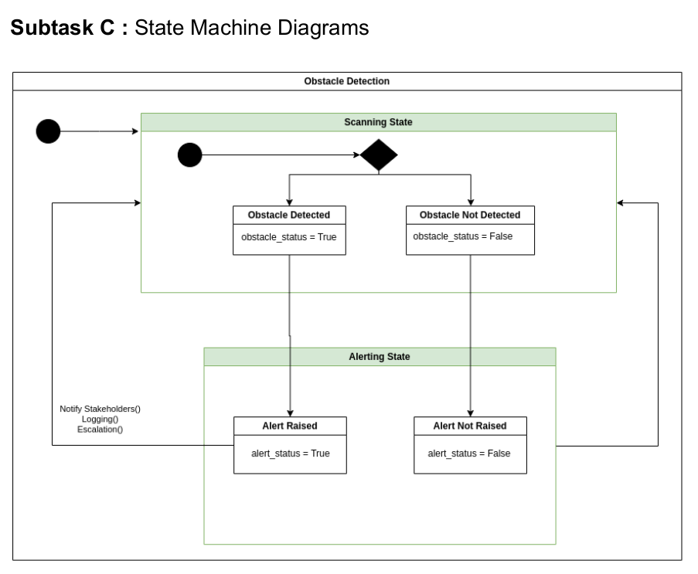
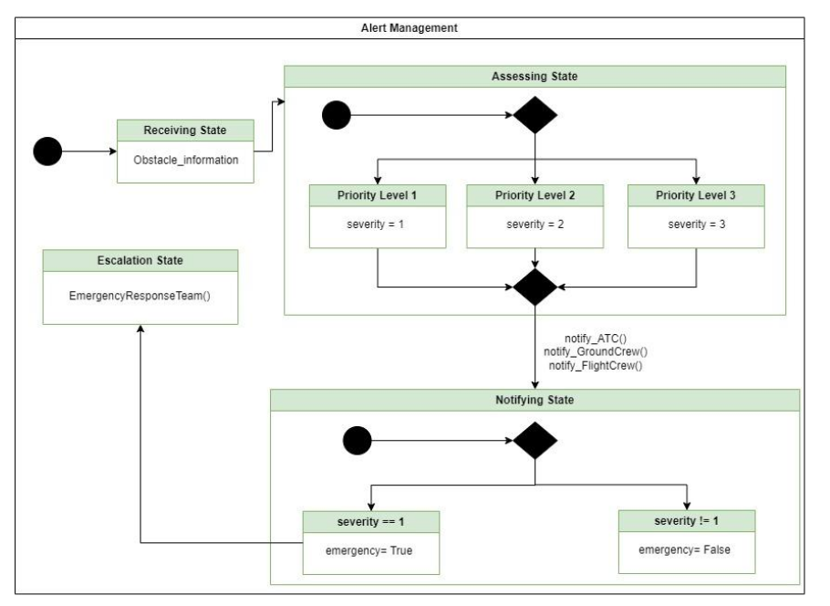
SysML
Usecase Diagram

Slide 13
Summary
FODS
FODS is an integral part of IAS system. It is also a safety critical system.
It helps in prioritizing the alerts adn helps stakeholders take sequential actions.
It uses modern AI tools, GPS systems, cloud services to create a map of airport and detect foreign objects in the map.

Slide 14
Thank you for your attention
Hintergrundbild-Platzhalter ist deaktiviert
→ über Menü „Start“ → Reiter „Bearbeiten“ → „Markieren“ → „Auswahlbereich“ → Ebene „Bild“ Symbol „Auge“ aktivieren → Bild in Platzhalter einfügen
!

